Slide 1
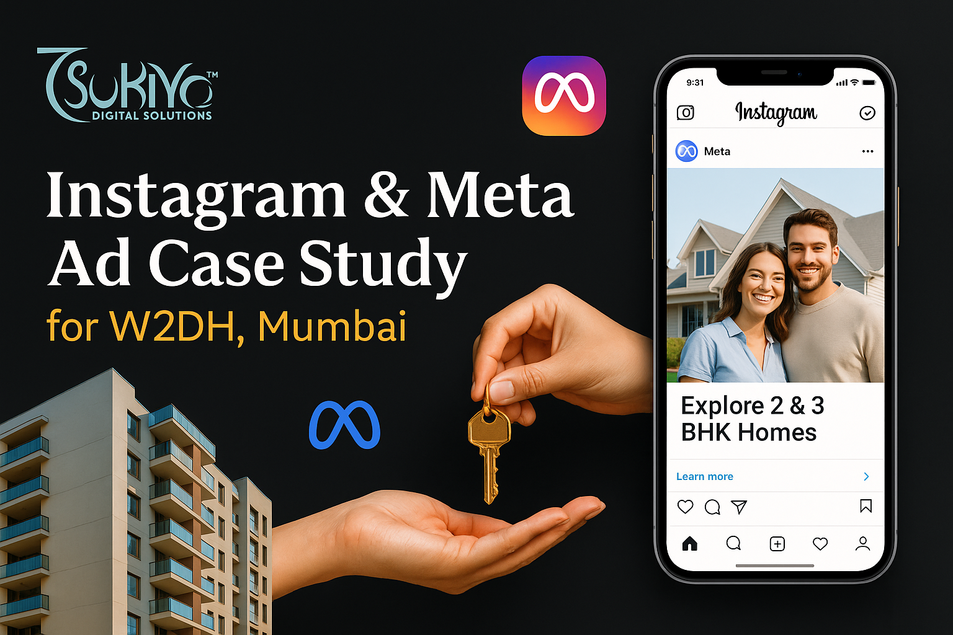
_{OF}

Slide 2
Business Challenge
W2DH Property Consultant, representing a real estate company in Mumbai having New projects and properties to sell Dahisar, and Virar, Kandiwali, Malad had previously been running ads but received many unqualified leads, users interested only in brochures or freebies, not actual buyers.
Core problem: They were getting lead volume, but conversion from lead to site visit or booking was low. They needed qualified leads with a serious intent to purchase.

Slide 3
Campaign Objectives
Drive qualified leads (i.e., genuine inquiries from homebuyers ready for next step)
Reduce CPL (Cost Per Lead) while improving lead quality
Build brand awareness in the targeted micro-markets

Slide 4
Campaign Performance: Before Optimization
Metric | Performance
Daily Budget | ₹2,000
Monthly Budget | ₹60,000
Leads per Day | 3–9
Total Leads/Month | 90–270
Cost per Lead (CPL) | ₹222 – ₹666
Qualified Leads/Month | ~30–50
Targeting | Broad/Generic Audience
Ad Creative | Single Static Image, No A/B Testing
Landing Page/Form | Basic, No Qualification Steps
Conversion Quality | Low

Slide 5
AFTER OPTIMISATION
Metric | Performance
Daily Budget | ₹2,000
Monthly Budget | ₹60,000
Leads per Day | 15 – 30
Total Leads per Month | 450 – 900
Cost Per Lead (CPL) | ₹67 – ₹133
Qualified Leads per Month | 100 – 200
Targeting | Refined targeting
Ad Creative | Multiple creatives
A/B Testing | Yes (ad creatives, headlines, CTA bts)
Landing Page/Form | forms with high qualification filters
Qualification Steps | intent-based questIons
Conversion Quality | Medium to High

Slide 6
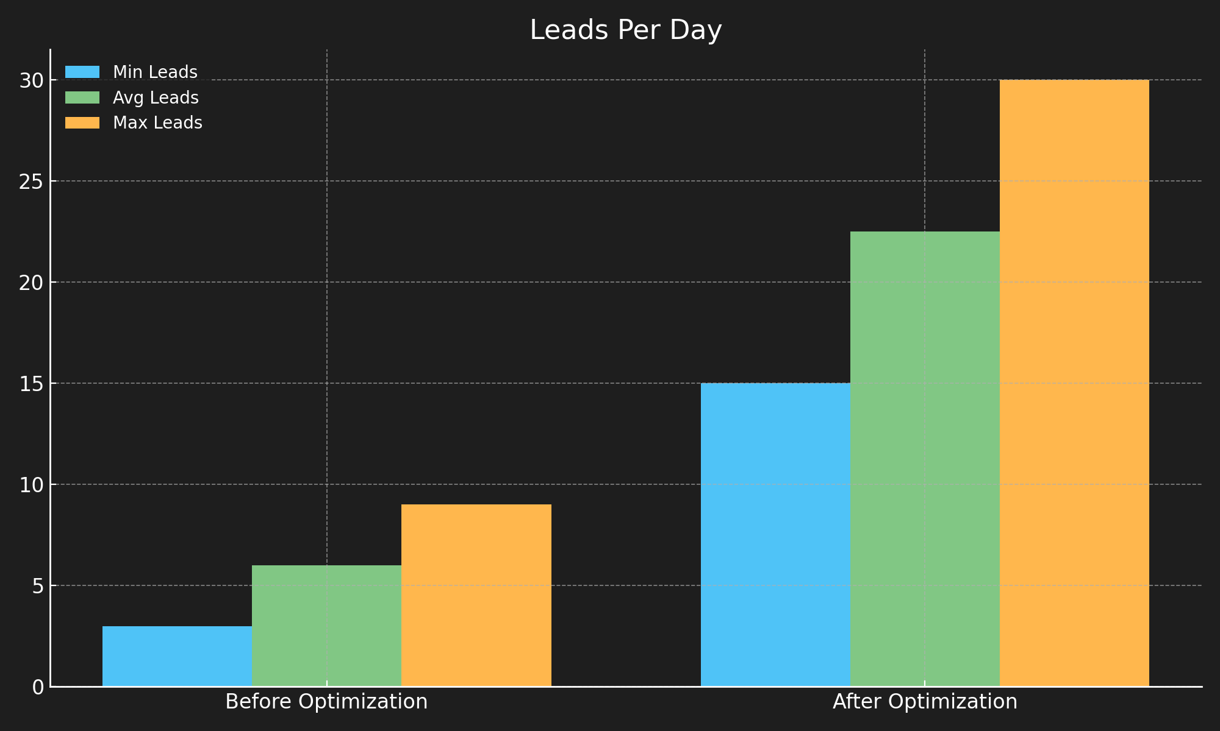
Leads Per Day

Slide 7
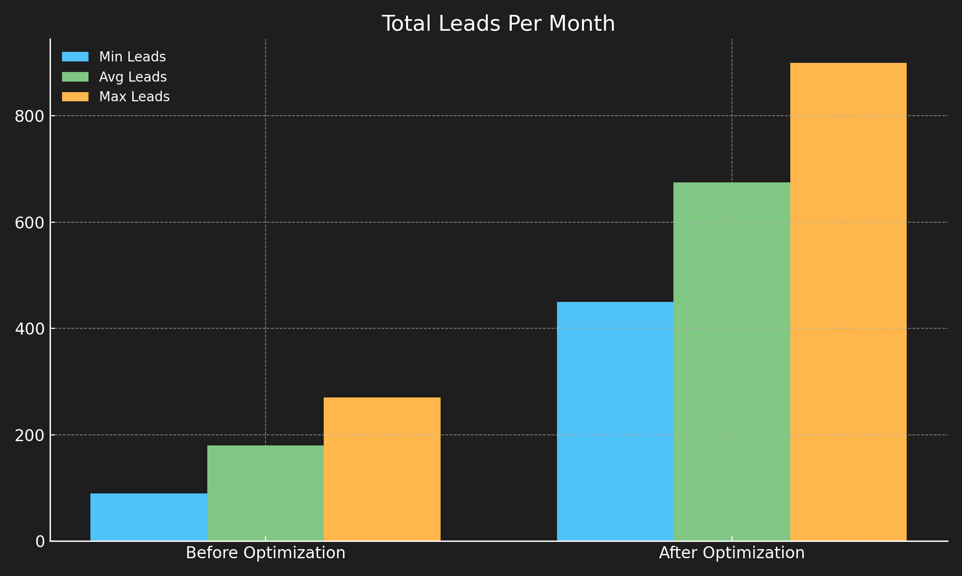
Leads Per Month

Slide 8
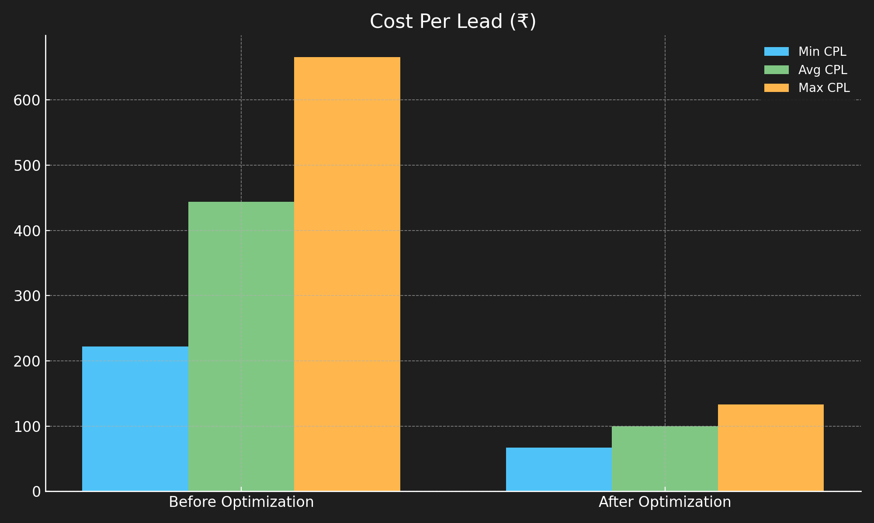
Cost Per Lead

Slide 9
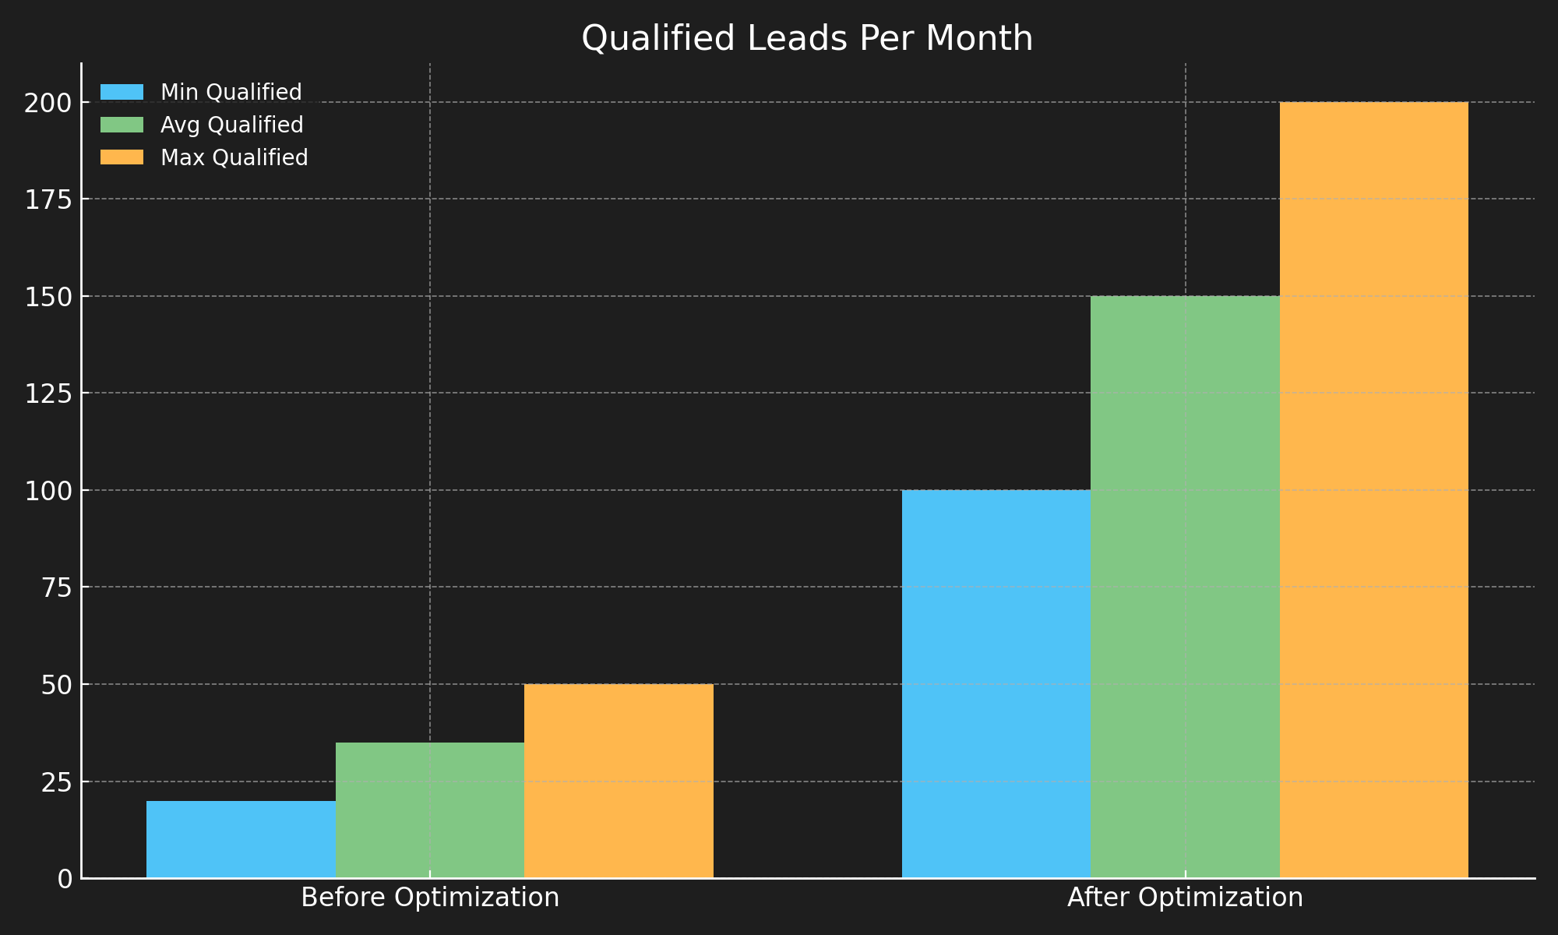
Qualified Leads Per Month

Slide 10
What Changed:
Budget remained ₹2,000/day (₹60,000/month)
Strategic overhaul across audience, funnel, creatives, and retargeting

Slide 11
How We Achieved Success
Refined targeting to focus on buyers more likely to convert
Introduced a multi-step funnel to filter high-intent leads
Used stronger visuals and messaging aligned with the property’s USP
Setup smart retargeting layers to re-engage warm audiences
Improved form structure to pre-qualify leads

Slide 12
Key Business Impact
More bookings & site visits
Sales team now gets better, pre-screened leads
Higher efficiency with same budget
Ads are now attracting the right audience, not just more traffic

