Slide 1


How We Grew a Jewellery Brand on
INSTAGRAM
Case Study: Akira Jewellery, Toronto, Canada
Notes:
Nkq
Jsfkhfkiflsff

Slide 2

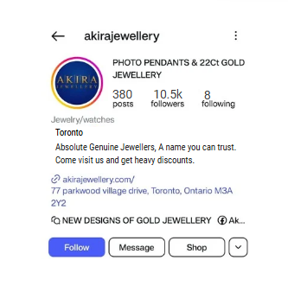
Client Overview
  Jewellery Type: 22Ct Gold Jewellery & PhotoPendants
  Target audience: Age 28 to 65
  Instagram presence before us
  followers : 10.5 k
  Posts: 380
  Consistency : 7 posts/week, 14 stories/week.

Slide 3
Key Issues
Captions & Content Lacked Engagement: Captions often lacked compelling hooks, storytelling elements, or clear calls-to-action. As a result, they didn’t spark meaningful interactions or prompt users to share the content.
Content Relevance & Variety: While consistent, the content sometimes felt repetitive or overly promotional. There was a missed opportunity to diversify formats and themes that could better resonate with the target audience.
Inconsistent Posting Times: Posts were not always published during peak engagement periods. This inconsistency likely affected visibility and reach, even when the content quality was high.

Slide 4
Key Issues
Unstructured Use of Stories: Stories were posted irregularly and lacked strategic planning. Interactive features like polls, questions, or behind-the-scenes snippets were underutilized, resulting in lower viewer retention and engagement.
Low Interaction with Followers: The client rarely replied to comments or DMs, and there was minimal effort to build relationships through replies, reposts, or shoutouts. This lack of community engagement may have created a one-sided experience for followers.
Lack of Engagement with Similar Brands: The client was not actively engaging with or following relevant, similar brands in their space. This limited their exposure to new audiences, potential collaborations, and opportunities to tap into existing communities.

Slide 5
Our Approach
To address the key performance gaps and enhance follower growth, a multi-layered strategy was implemented, focusing on engagement, content refinement, and audience alignment:
Caption Optimization: We Optimised the content in introduction and introduced engaging, value-driven captions that included clear calls-to-action, questions, and storytelling elements to encourage interaction and sharing.
Content Strategy Revamp: The content mix was strategically diversified to include a well-balanced combination of carousels, Reels, behind-the-scenes content, and engaging Stories. Interactive elements—such as quizzes, polls, and time-sensitive offers—were regularly incorporated into Stories to spark follower participation and increase retention. Content pillars were clearly defined to ensure consistency, improve relevance, and strengthen brand identity across all platforms.

Slide 6
Our Approach
Strategic Scheduling: Posting times were aligned with peak engagement periods based on platform analytics. A content calendar was introduced to ensure consistency and to capitalize on high-traffic days and times.
Revamped Story Strategy: A structured story framework was developed with daily or weekly themes. Interactive features like polls, questions, quizzes, and countdowns were incorporated to boost viewer participation and retention.
Community Engagement: We initiated regular engagement with followers through prompt replies, comment interactions, and follower features (e.g., reposting tagged content). This fostered a stronger sense of community and increased brand loyalty.

Slide 7
Our Approach
Collaborative Networking: The client began actively engaging with similar and complementary brands through comments, shares, and collaborations. This expanded their visibility within their niche and introduced the brand to new, relevant audiences
Targeted Post Promotion: To enhance reach and visibility, we implemented a data-driven boosting strategy. High-performing posts and those aligned with specific campaign objectives were selectively promoted to targeted audience segments. This approach not only increased engagement rates but also helped attract new followers and improve overall content performance.

Slide 8
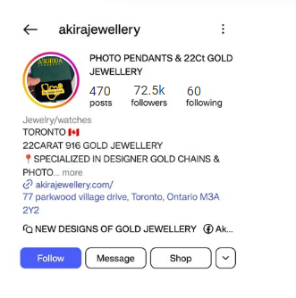
Performance Highlights
The implemented strategy delivered measurable improvements across key performance metrics, validating the effectiveness of the revised approach:
Significant Follower Growth: A noticeable uptick in follower count was observed over the course of the campaign, narrowing the gap with key competitors.

Slide 9
Performance Highlights
Higher Engagement Rates: Improved content quality, interactive stories, and strategic post boosting led to a substantial increase in likes, comments, shares, and story interactions.
Increased Reach & Visibility: Boosted posts and a consistent posting schedule helped expand organic and paid reach, putting the brand in front of a broader, more relevant audience.
Better Community Connection: Enhanced interaction with followers—through replies, DMs, and user-generated content features—fostered a stronger sense of community and brand loyalty.

Slide 10
Performance Highlights
Improved Content Performance: Carousels, Reels, and behind-the-scenes content saw higher retention and engagement rates, confirming the effectiveness of the revised content mix.
Story Engagement Spike: The addition of quizzes, offers, and interactive elements resulted in a marked increase in story views, taps, and responses.

Slide 11
Results in a Nutshell
In just 3.2 months, the client experienced a remarkable transformation in both engagement and overall social media growth. Through a targeted, insight-driven approach, we were able to not only boost visibility and interaction but also build a stronger, more connected community—setting the foundation for long-term digital success.

